Slide 1

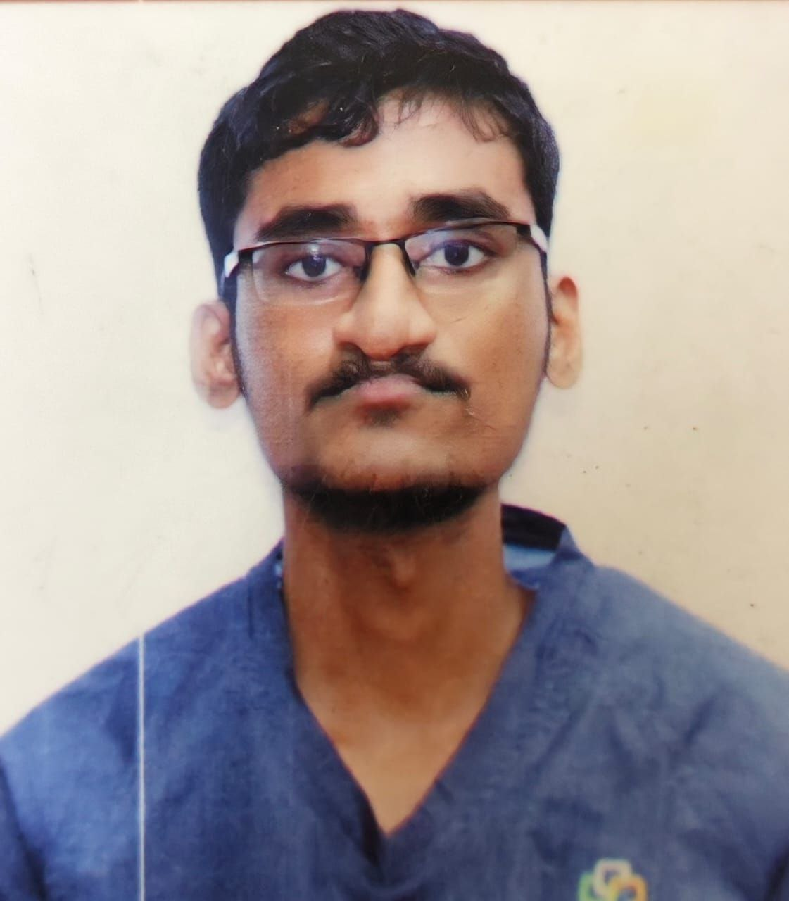
Dr. BALARAM
PROMETHEANS [2020 – 2025]
Saveetha Medical College, Saveetha Institute of Medical and Technical Sciences.

Slide 2
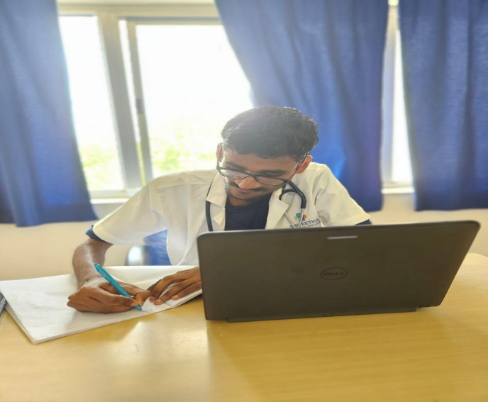
Dr. BALARAM
Bachelor of Medicine, Bachelor of Surgery
PREFACE
PROMETHEANS 2020–2025 | Saveetha Medical College Hospital
Achievements
•
Education is a ray of light in darkness. My vision is to become an academician, thereby impart the right
education and inculcate refined qualities
among the next generation students – simply like a candle
“The good physician treats the disease; the great physician treats the patent who has the disease”
melting itself by providing light to shine. Teaching and demonstration sessions have never failed to amaze
me during my undergraduate program, which encouraged me to work towards becoming an academician
---William Osler
such that I hold the position of a professor/ clinical instructor.
Personal Introduction
I wanted a profession that will satisfy me, challenge me and bring me joy. I believe that a job should be like a hobby – where I want to love my work and know that I am making a diﬀerence in this world by helping others. I know it requires a tremendous amount of patience and hard work. The environment at Saveetha Medical College was simply catalytic in nature which motivated me to go extra mile in every sphere in bringing the best out of me.
•
I believe that the best way to stay mo4vated, is by visualizing one’s achievement & working hard to reach
their goal. I believe that the purpose of life is just not to be happy. it is to be useful, honorable,
compassionate and to have it make some diﬀerence that we had lived and lived well.
“The best way to ﬁnd yourself is to lose yourself in the service of others.”
— Mahatma Gandhi
“A physician is obligated to consider more than a diseased organ, more than even the whole man—he must view the man in his world.”
I am fortunate to have grown in a very competitve environment in my medical school which has kindled me to always keep working harder and use this freedom righteously to raise my standards as a professional and as a good human rather than be another conven4onal physician.
— Harvey Cushing

Slide 3
Phase 3B
1 |
Page
SAVEETHA MEDICAL COLLEGE HOSPITAL

Slide 4
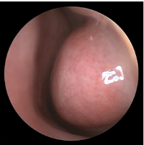
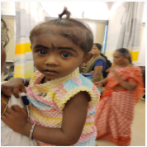
Student Name: BALARAM.S
A case of URTI
Reg. no: 112001035
S.no: 1 PID: 240909243117
Name: Tamilini K Age: 2 Gender: Female
Brief Clinical History:
C/o fever for past 3 days
Patient was apparently normal 3 days before after which she developed fever for past 3 days, sudden in onset, progressive in nature, aggravating on night and reliving on medications.
H/o cough, vomiting (food particles+, white in colour).
No h/o ear and throat complaints, hoarseness of voice, stridor, wheezing, trismus, rashes on body, weight loss, night sweats, diarrhea, asthma, skin lessions, decreased urine output, chills and rigor
Workup:
On arrival child was alert, conscious and oriented to time, place and person.
Development history = patient was developed upto the age
Dietary history = normal
Vitals= PR: 108/min, RR: 22/min, Spo2-98%, temp: 100 F
Anthropometry = weight: 12.5kg, height: 87cm
Nasal examination= inferior turbinate hypertrophy, nasal discharge +
Differential diagnosis / Clinical insights :
  Allergic rhinitis
  LRTI
  Asthma
  Tuberculosis
  Paediatric retropharyngeal abscess
  Pneumonia
  Sinusitis
Management / Procedure done:
Cbc findings= TLC is elevated, normal rbc count.
Syp. Advent 5ml (3.5 ml BD for 5 days)
Syp. Ambrolite s ( 2.5ml TDS for 3 days),
Syp. Paracetamol 120 for 3 days
1 |
Page
SAVEETHA MEDICAL COLLEGE HOSPITAL

Slide 5
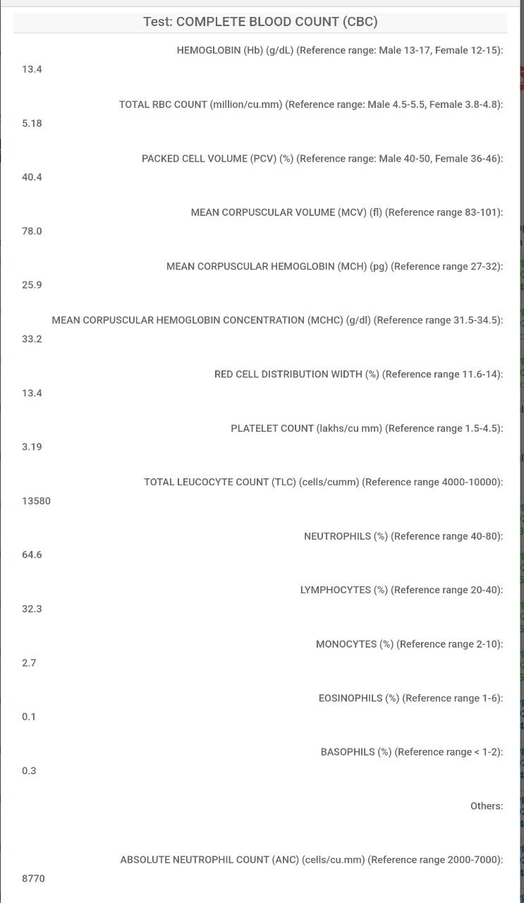
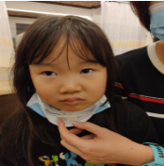
Student Name: BALARAM.S
A case of gastroenteritis
Reg. no: 112001035
S.no: 2 PID: 240807232336
Name: Lan watanabe Age: 5 Gender: female
Brief Clinical History:
C/o diarrhoea for past 2 days
Diarrhoea for past 2 days, sudden in onset, progressive in nature, no aggravating and reliving factors. H/o fever, diarrhoea ( waterly in consistency, brown in color, 2 episodes), abdominal pain, running nose, cough
No h/o vomiting, headache, body rashes, blood in stools, signs of dehydration, vomiting, weight loss, chills, rigor, skin rashes, joint pain
Pic with pa/ent
Radiological/ Procedure Image
Workup:
On arrival child was alert, conscious and oriented to time, place and person.
Development history= patient was developed upto the age
Dietary history = normal
Vitals= PR: 96/min, RR: 18/min, Spo2-98%, temp:101 F
Anthropometry = weight: 19.7 kg, height:117cm
Abdomen examination= soft, non tender, no organomegaly
Differential diagnosis / Clinical insights :
Peptic ulcer
Inflammatory bowel disease
Typhoid fever
Food poisoning
Management / Procedure done:
Cbc= TLC is elevated, absolute neutrophils count are increased
Syp. Paracetamol 60ml ( 6ml )
EMUNZ SUS 5 ML
ZINCONIA SYP 100 ML
ELECTRAL 21 GM
2 |
Page
SAVEETHA MEDICAL COLLEGE HOSPITAL

Slide 6
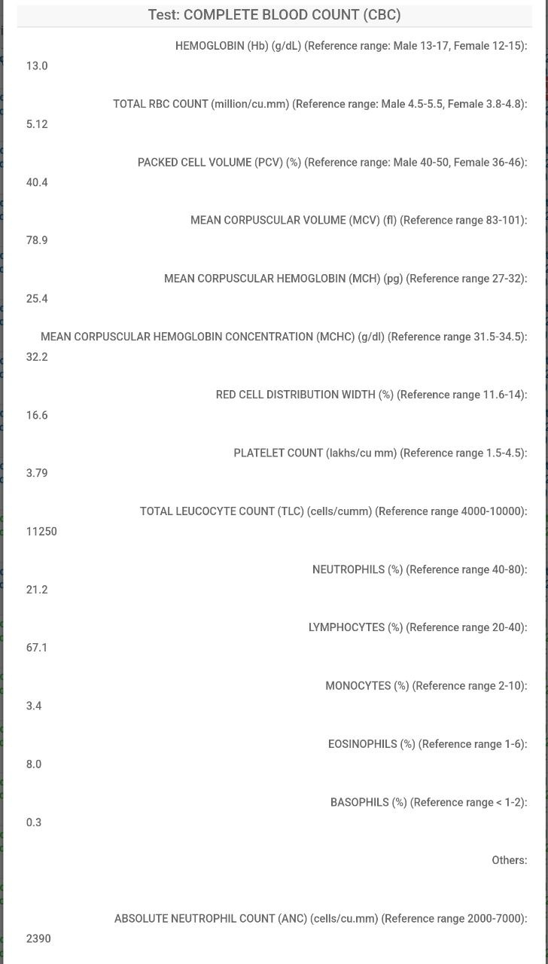
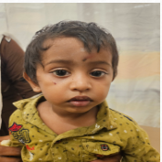
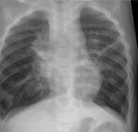
Student Name: BALARAM.S
A case of LRTI/ ASTHMA
Reg. no: 112001035
S.no: 3 PID: 240719226677
Name: Ashwin S Age: 1 Gender: Male
Brief Clinical History:
C/o fever and cough with expectoration 10 days
Pt was apparently normal 10 days back after which he developed low grade fever, sudden in onset, continuous, not relieved on medication. H/o cough with expectoration x 10 days, sudden in onset, mucoid, white sputum, no aggravating or relieving factor.
No h/o ear and throat complaints, hoarseness of voice, stridor, trismus, rashes on body, weight loss, night sweats, diarrhea, skin lessions, decreased urine output, chills and rigor
Pic with pa/ent
Radiological/ Procedure Image
Workup:
On arrival child was alert, conscious and oriented to time, place and person.
Development history= patient was developed upto the age
Dietary history = normal
Vitals= PR: 126/min, RR: 20/min, Spo2-98%, temp: 100 F
Anthropometry = weight:9.5Kg, height:79 cm
Respiratory examination= Wheeze on bilateral mammary and infra axillary region
Differential diagnosis / Clinical insights :
  Inhaled foreign body
  URTI
  Asthma
  Tuberculosis
  Pneumonia
  pneumothorax
Management / Procedure done:
Chest xray = consolidation were present
Cbc= TLC is elevated, lymphocytes are increased
Pulmonary function test were done
MDI budecort 100mcg 1 puff BD
Syp.montek lc P/O 3.5ml p/o HS
3 |
Page
SAVEETHA MEDICAL COLLEGE HOSPITAL

Slide 7
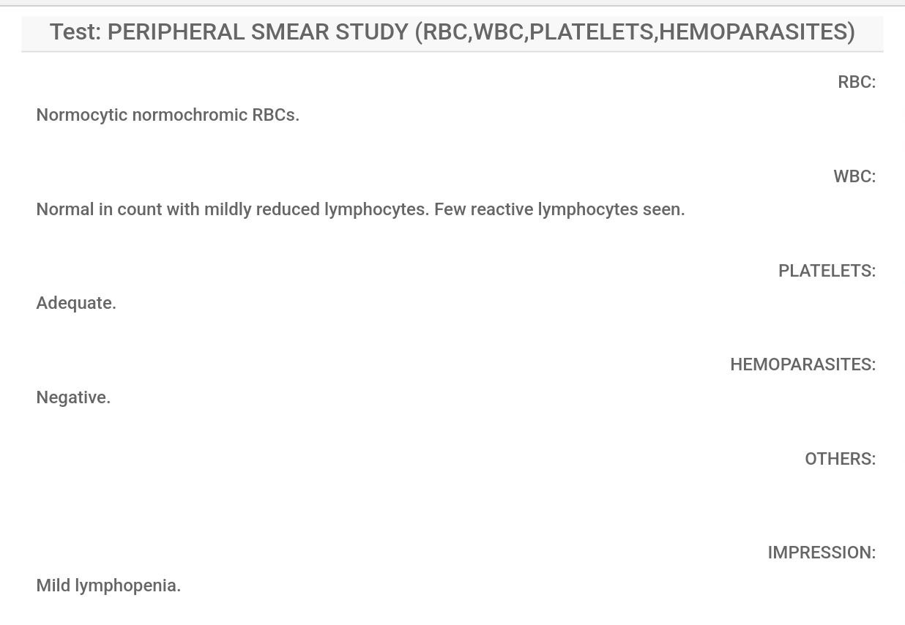
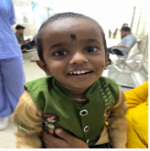
Student Name: BALARAM.S
A case of FEBRILE SEIZURES/UTI
Reg. no: 112001035
S.no: 4 PID: 230621100910
Name: Kiruthiswara R Age: 3 Gender: Male
Brief Clinical History:
Fever for past 5 days
Patient was apparently normal 5 days back after which he developed fever for past 5 days, sudden in onset progressive in nature, no aggravating and reliving factors.
H/o vomiting (2 episodes, watery in consistency,foul smelling), cough with expectoration, breathlessness, seizure(1 episodes), loss of appetite. No h/o diarrhoea, phimosis, headache, throat and ear complaints, skin rashes, hoarseness of voice, neck stiffness, altered consciousness, head trauma
Pic with pa/ent
Radiological/ Procedure Image
Workup:
On arrival child was alert, conscious and oriented to time, place and person.
Development history= patient was developed upto the age
Dietary history = normal
Vitals= PR: 102/min, RR: 18/min, Spo2-98%, temp: 100 F
Anthropometry = weight:11Kg, height:89 cm
CNS examination= NFND, no loss of consciousness, no altered sensorium
Differential diagnosis / Clinical insights :
Meningitis
Encephalitis
Brain abscess
Hypoglycemia
Dravet syndrome
Management / Procedure done:
Cbc= TLC is elevated and neutrophills count also elevated
Peripheral blood smear= mild lymphopenia present
Syp. Para(250/5) 4 ml q6h
Tab. Frisium 5 mg
Tab Inj.Cefotaxim 750mg iv bd
Syp.Relent 2.5ml bd
4 |
Page
SAVEETHA MEDICAL COLLEGE HOSPITAL

Slide 8
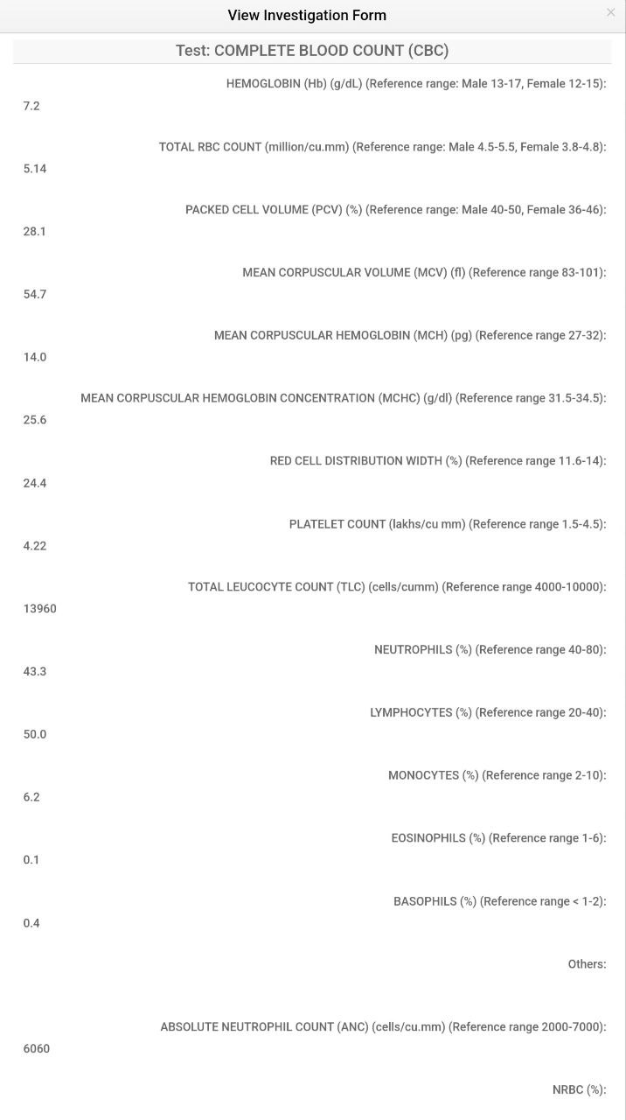
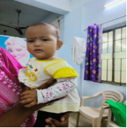
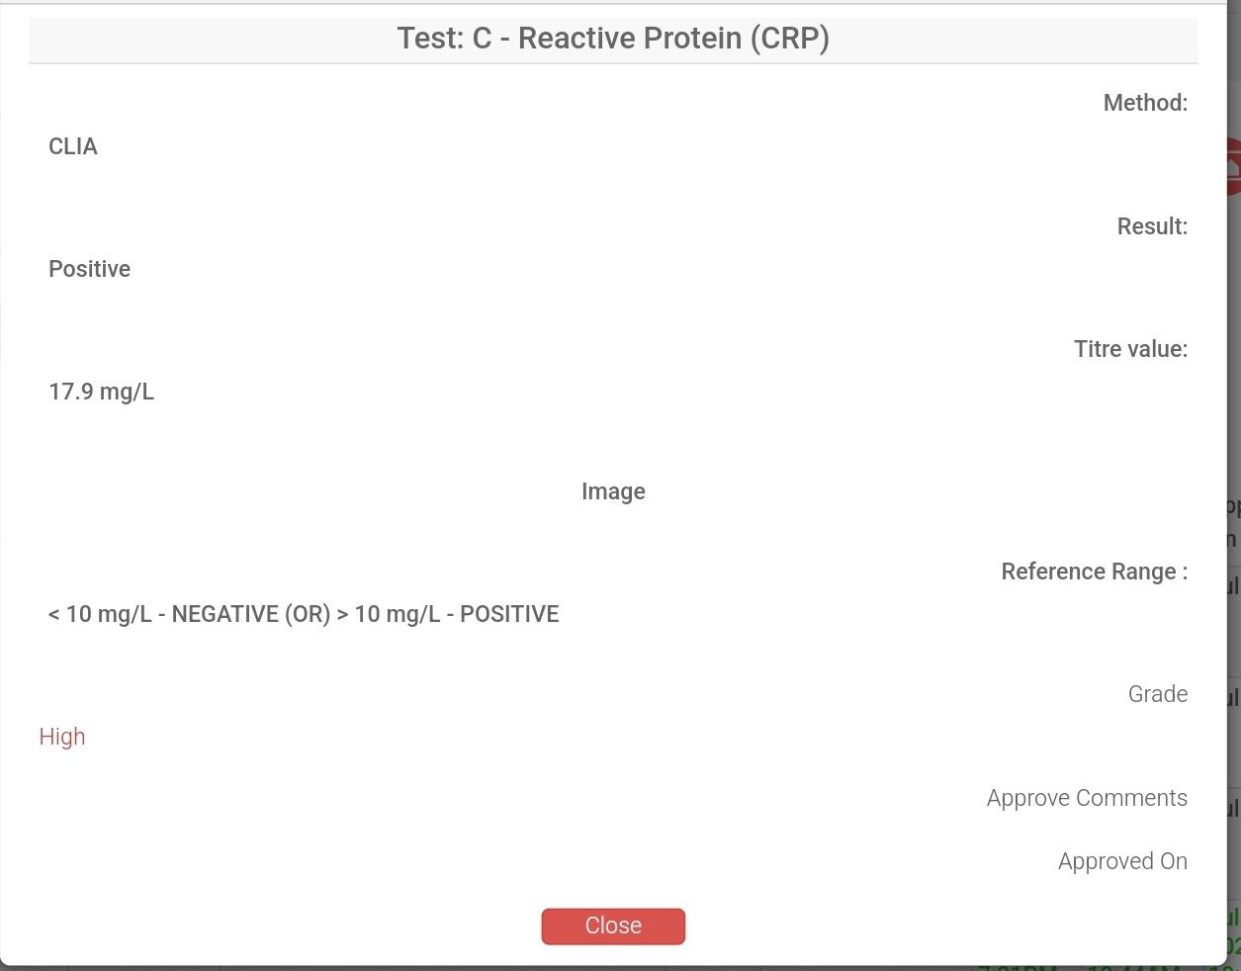
Student Name: BALARAM.S
A case of URTI
Reg. no: 112001035
S.no: 5 PID: 23022863058
Name: Saisha Heymu Age: 1 Gender: female
Brief Clinical History:
Cough for past 4 days
Patient was apparently normal 4 days before after which he developed Cough for past 4 days, sudden in onset, no aggrevated and reliving factors. H/o cough (waterly in consistency, no odour), difficulty in passing stools
No h/o fever, vomiting, diarrhoea, breathlessness, ear and throat complaints, hoarseness of voice, stridor, wheezing, trismus, rashes on body, weight loss, night sweats, diarrhea, asthma, skin lessions, decreased urine output, chills and rigor
Pic with pa/ent
Radiological/ Procedure Image
Workup:
On arrival child was alert, conscious and oriented to time, place and person.
Development history= patient was developed upto the age
Dietary history = normal
Vitals= PR: 128/min, RR: 22/min, Spo2-98%, temp: 98F
Anthropometry = weight: 10kg, height: 83cm
Nasal examination= inferior turbinate hypertrophy, nasal discharge +
Differential diagnosis / Clinical insights :
  Allergic rhinitis
  LRTI
  Asthma
  Tuberculosis
  Paediatric retropharyngeal abscess
  Pneumonia
  Sinusitis
Management / Procedure done:
Cbc= TLC is elevated and lymphocytes also elevated, hb is low
CRP= Increased
Nasoclear nasal drops- 1 drop per nostril for 3 days
Syp. Maxtra 2.5ml BD for 3 days
5 |
Page
SAVEETHA MEDICAL COLLEGE HOSPITAL

